Slide 1

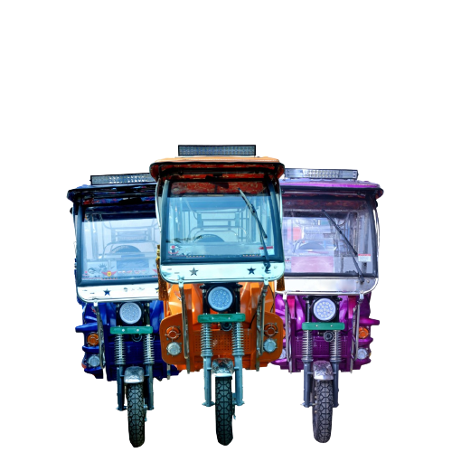
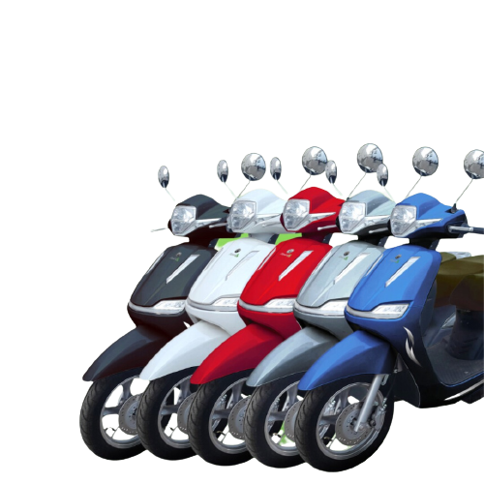
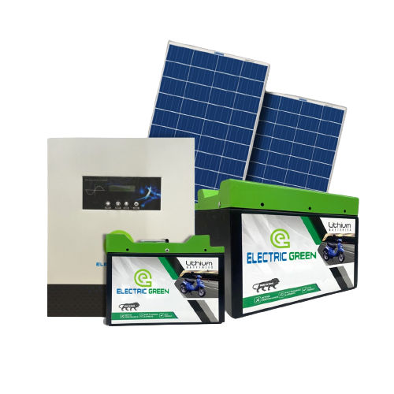
GO GREEN WITH
ELECTRIC GREEN
g

Slide 2

About our Company
Welcome to Electric Green, where innovation meets sustainability. As a pioneering force in the realm of electric mobility and energy solutions, we are dedicated to shaping a cleaner and brighter future for generations to come. Our commitment to eco-conscious technologies and forward-thinking practices drives us to develop cutting-edge electric vehicles and energy storage solutions that are not only efficient and reliable but also environmentally friendly.
At Electric Green, we believe in the power of green energy to transform the way we live and move. With a focus on sustainable development and a passion for innovation, we aim to redefine the possibilities of electric transportation and energy storage. Join us in our mission to drive progress and preserve the planet by exploring our range of electric vehicles, lithium-ion batteries, and innovative energy solutions.
Discover the future of mobility and energy with Electric Green. Together, let's power up for a greener and more sustainable tomorrow.

Slide 3
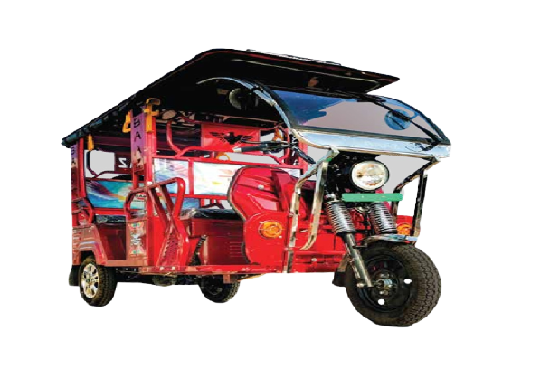
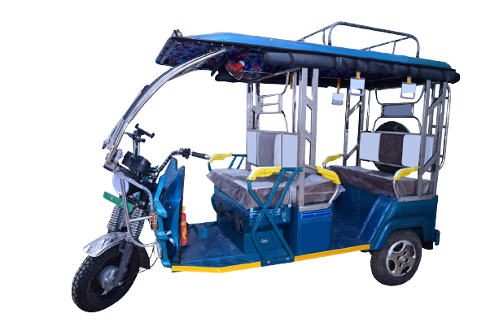
MODEL
DELUXE EXTRA POWER (MS/SS)
TECHNICAL SPECIFICATION
MOTOR – 1000W BLDC MOTOR
SPEEDOMETER – INDIAN METER
LIGHTS – LED HEADLIGHT WITH DRL
CONTROLLER – 24 TUBES, DC BRUSHLESS
MAX SPEED – 25Kms/hr
DIMENSIONS – 2762X990X1790MM
TYRES – 3-75-12 (BEDROCK SUPREME)
LIFE TIME WARRANTY
SHOCKER – 31 inches 43 mm
RANGE/CHARGE – 110-120 Kms
ACCELERATORE – HAND/FOOT
ROOF – HEAVY ROOF METAL
LOAD CAPACITY – 360+40kg OR 4+1 PERSON
CHARGER – 48/18 EASTMAN
MODEL
DELUX (MS/SS)
TECHNICAL SPECIFICATIONS
MOTOR – 1000W 999 BLDC MOTOR
CONTROLLER – 48W, DC BRUSHLESS
MAX SPEED – 25 KMS/hr
DIMENSIONS – 2762X990X1790MM
TYRE – 3-75-12 (BEDROCK SUPREME)
LIFE TIME WARRANTY
SHOKERS – 31 inches 43mm
RANGE/CHARGE – 100-110 kms
ROOF – CR METAL
LOAD CAPACITY – 360+40Kg OR 4+1 PERSON
CHARGER – 48/18 EASTMAN

Slide 4
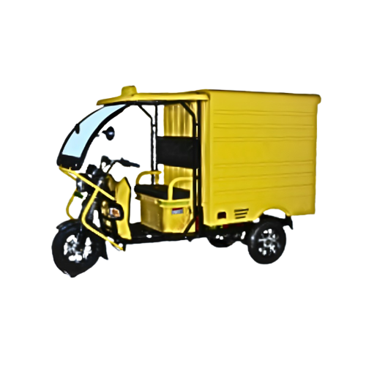
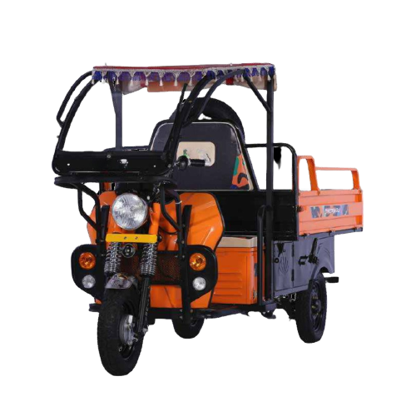
MODEL
LOADER AND BOX LOADER
TECHNICAL SPECIFICATIONS
CARGO BOX-48X72X24 – CABINE LIGHT FOR
DRIVER MATTING
MOTOR – 1250 WATT
EXTRA SPACE BELOW
THE – TOOL KIT
CARGO BOX (DALA) – REMOTE CENTER
LOCKING FIRE CYLINDER
TYRE’S SIZE 3.75X12 – FM & FRONT SS GLASS
REAR SHOCKER WITH
HEAVY KAMANI – JACK
50 AMP CHARGING
SOCKET – WATER BOTTEL HOLDER
EARTHING SHEET – MOBILE CHARGING SOCKET
USE BOX TECHNOLOGY – FIRST AID KIT

Slide 5
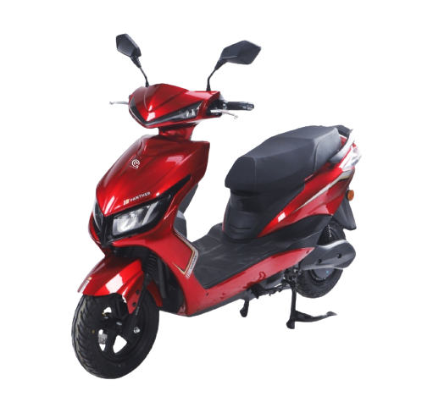
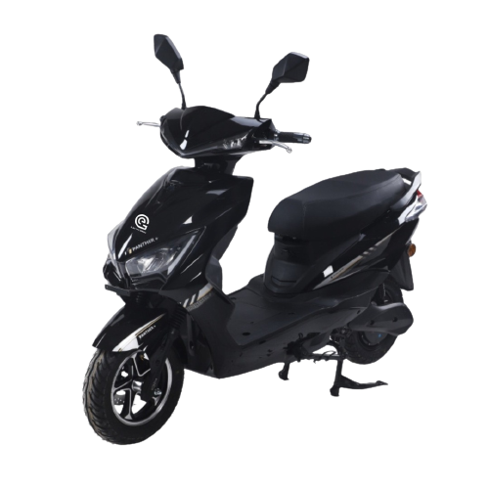
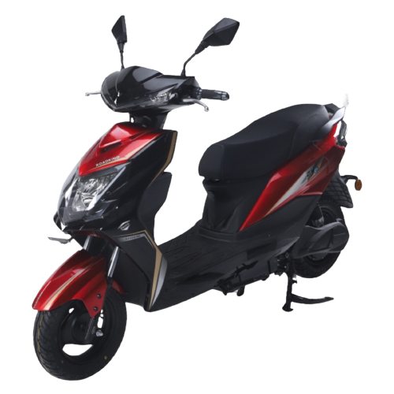
HIGH SPEED MODELS
PANTHER
PANTHER +
ROAD KING
Mileage (90 – 100 kms*)
All Models In Four Colours
15 Degree Climbing Angle
Led Display Panel
Electronically Assisted Breaking System
4 Speed modes (Eco/City/Thrust/Reverse)
USB Charging Port
Max Speed (45-50kmph*)
Side Stand Sensor
Finance Facilities Available*
BLDC Motor (1.8kw Peak)
Central Locking System

Slide 6
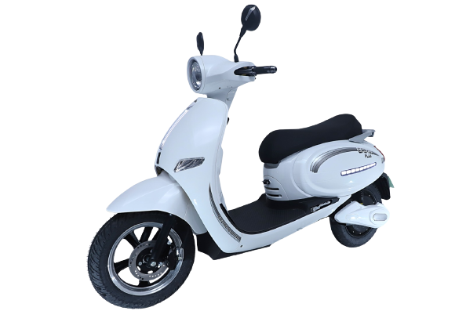
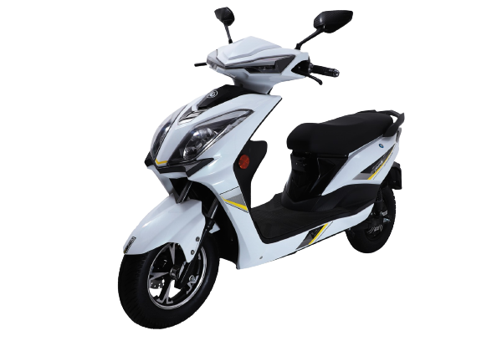
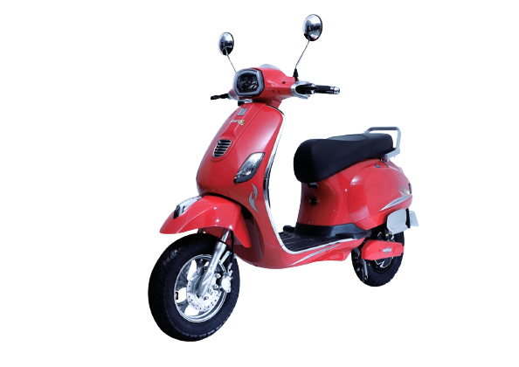
EASYGO PLUS
FUTURE 2020
Brand : Electric Green
Type : Low Speed
EASYGO PRO
Max Speed : 25 km/hr
Colour : Silver, Red, Black, White
Battery Type : Lithium Ion & Lead Acid

Slide 7
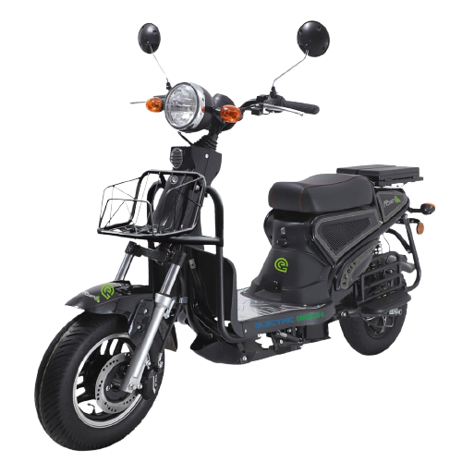
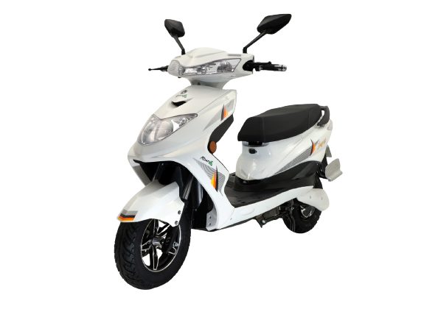
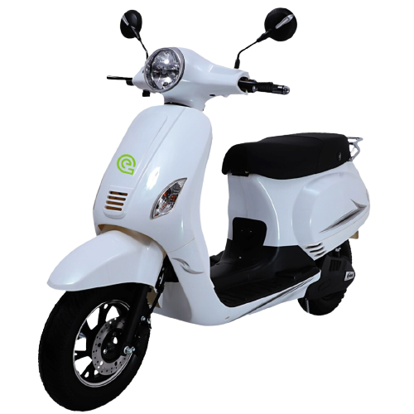
JUGNI
EASYGO CLASSIC
LOADER
Brand : Electric Green
Type : Low Speed
Max Speed : 25 km/hr
Colour : Silver, Red, Black, White
Battery Type : Lithium Ion & Lead Acid

